Slide 1
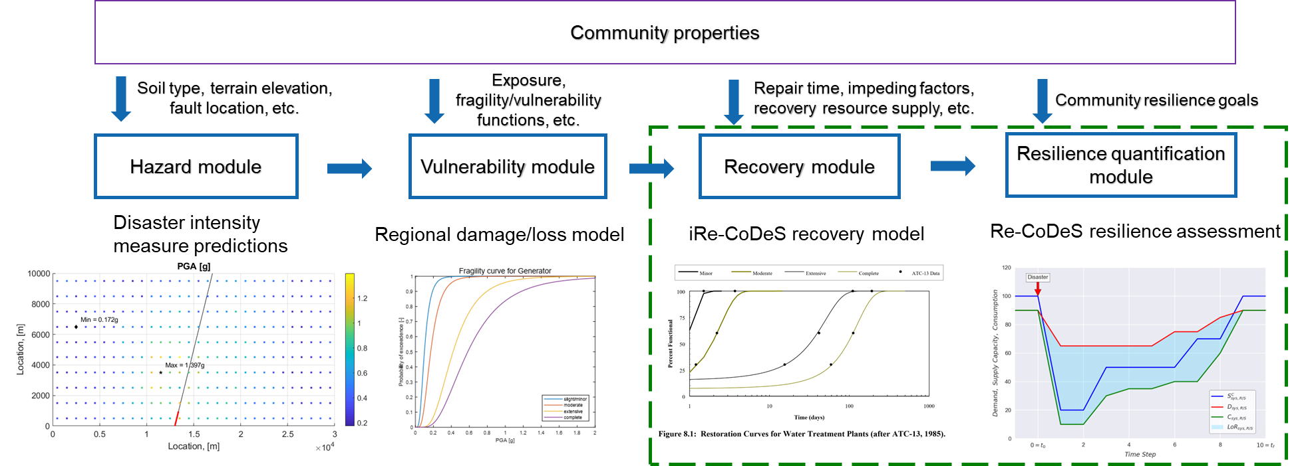
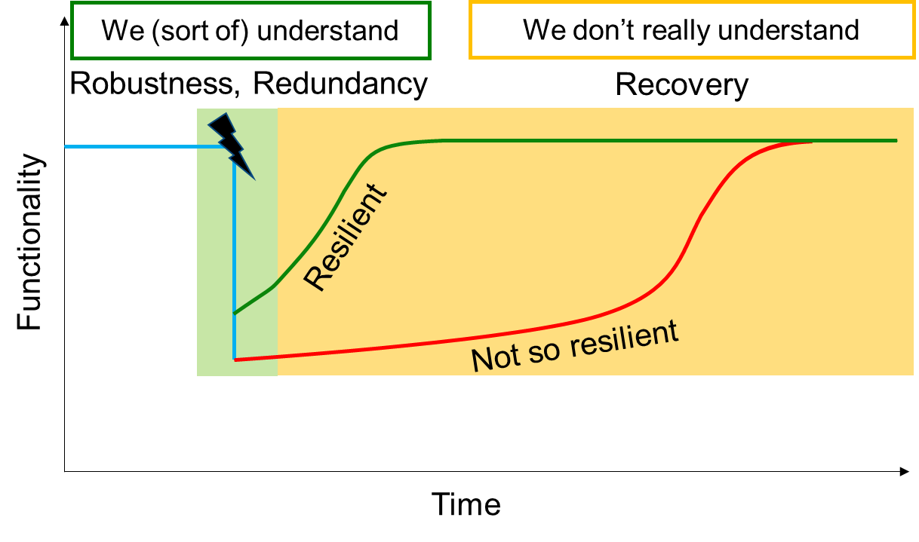
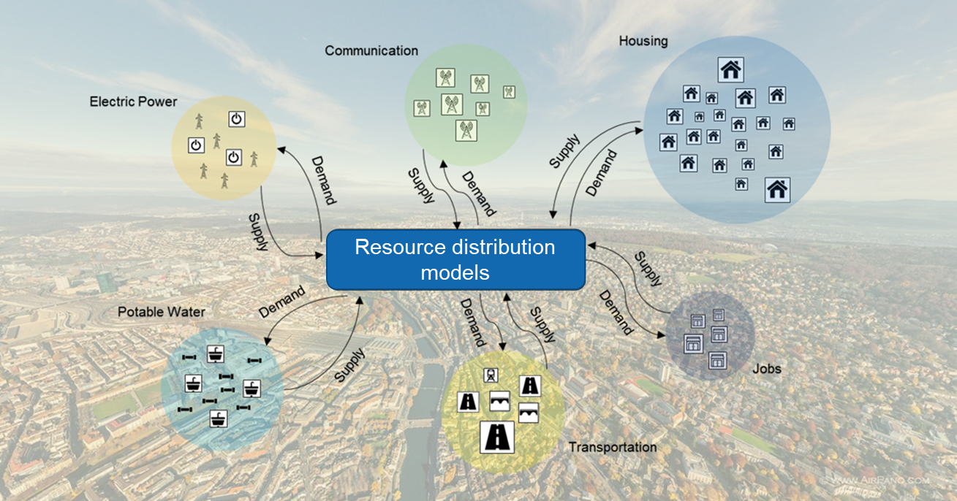
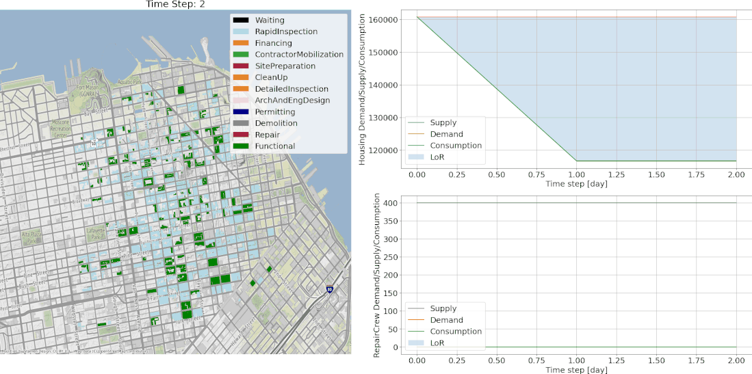
Recovery modelling needs to be improved to better understand system’s resilience
Physics-based and modular computational workflow based on existing regional risk assessment tools used to assess resilience
Interdependencies among systems/components captured by simulating flow of resources and looking at resource demand fulfillment
iRe-CoDeS framework applied to housing and interdependent infrastructure to simulate recovery and assess disaster resilience

Slide 3
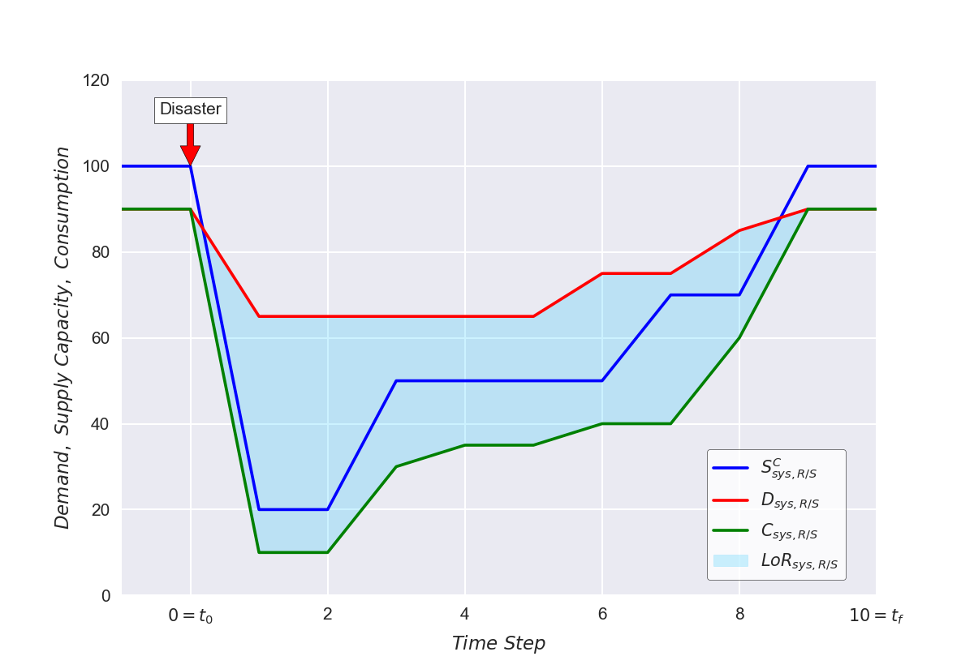
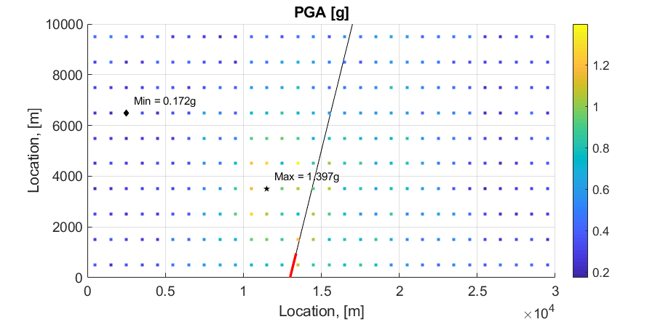
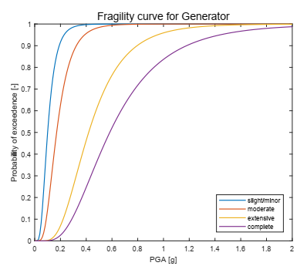
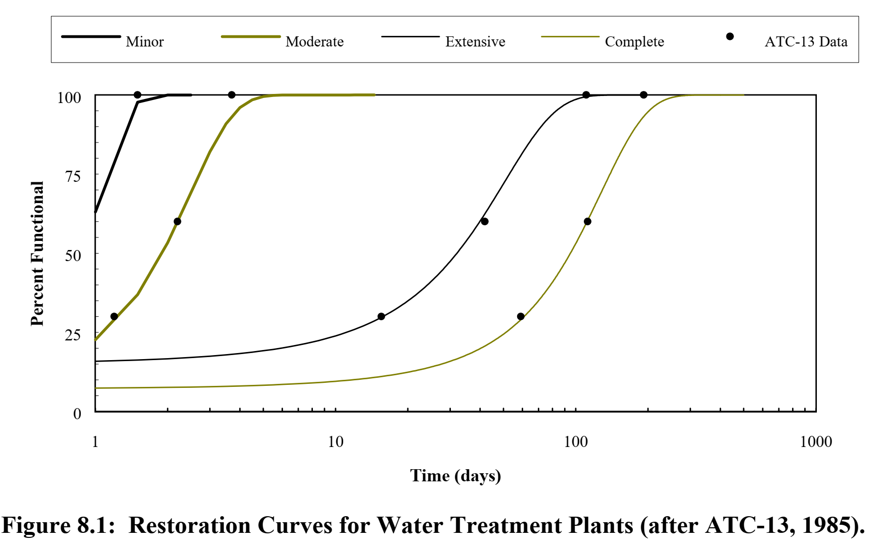
Community properties
Soil type, terrain elevation, fault location, etc.
Exposure, fragility/vulnerability functions, etc.
Repair time, impeding factors, recovery resource supply, etc.
Community resilience goals
Hazard module
Vulnerability module
Recovery module
Resilience quantification
module
Disaster intensity measure predictions
Regional damage/loss model
iRe-CoDeS recovery model
Re-CoDeS resilience assessment
Resilience Assessment
Motivation
Blagojević, Kipfer, Didier, Stojadinović (2020) Probability-based Resilience Assessment of Communities with Interdependent Civil Infrastructure Systems. Proceeding of the 17th World Conference on Earthquake Engineering. Sendai, Japan.
Blagojević, Kipfer, Didier, Stojadinović (2020) Scenario-based Resilience Assessment of Communities with Interdependent Civil Infrastructure Systems. Proceeding of the 17th World Conference on Earthquake Engineering. Sendai, Japan.

Slide 4
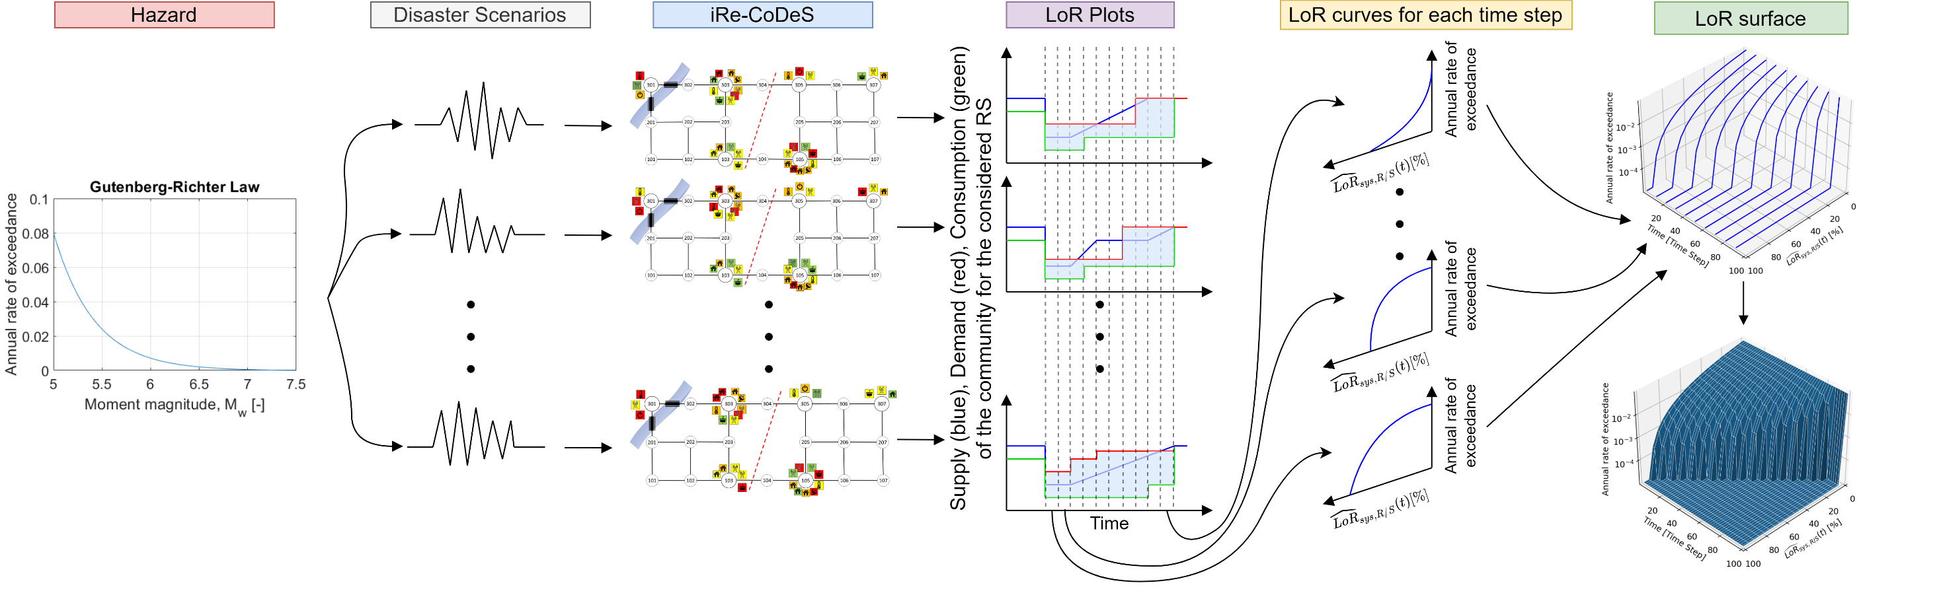

Slide 5
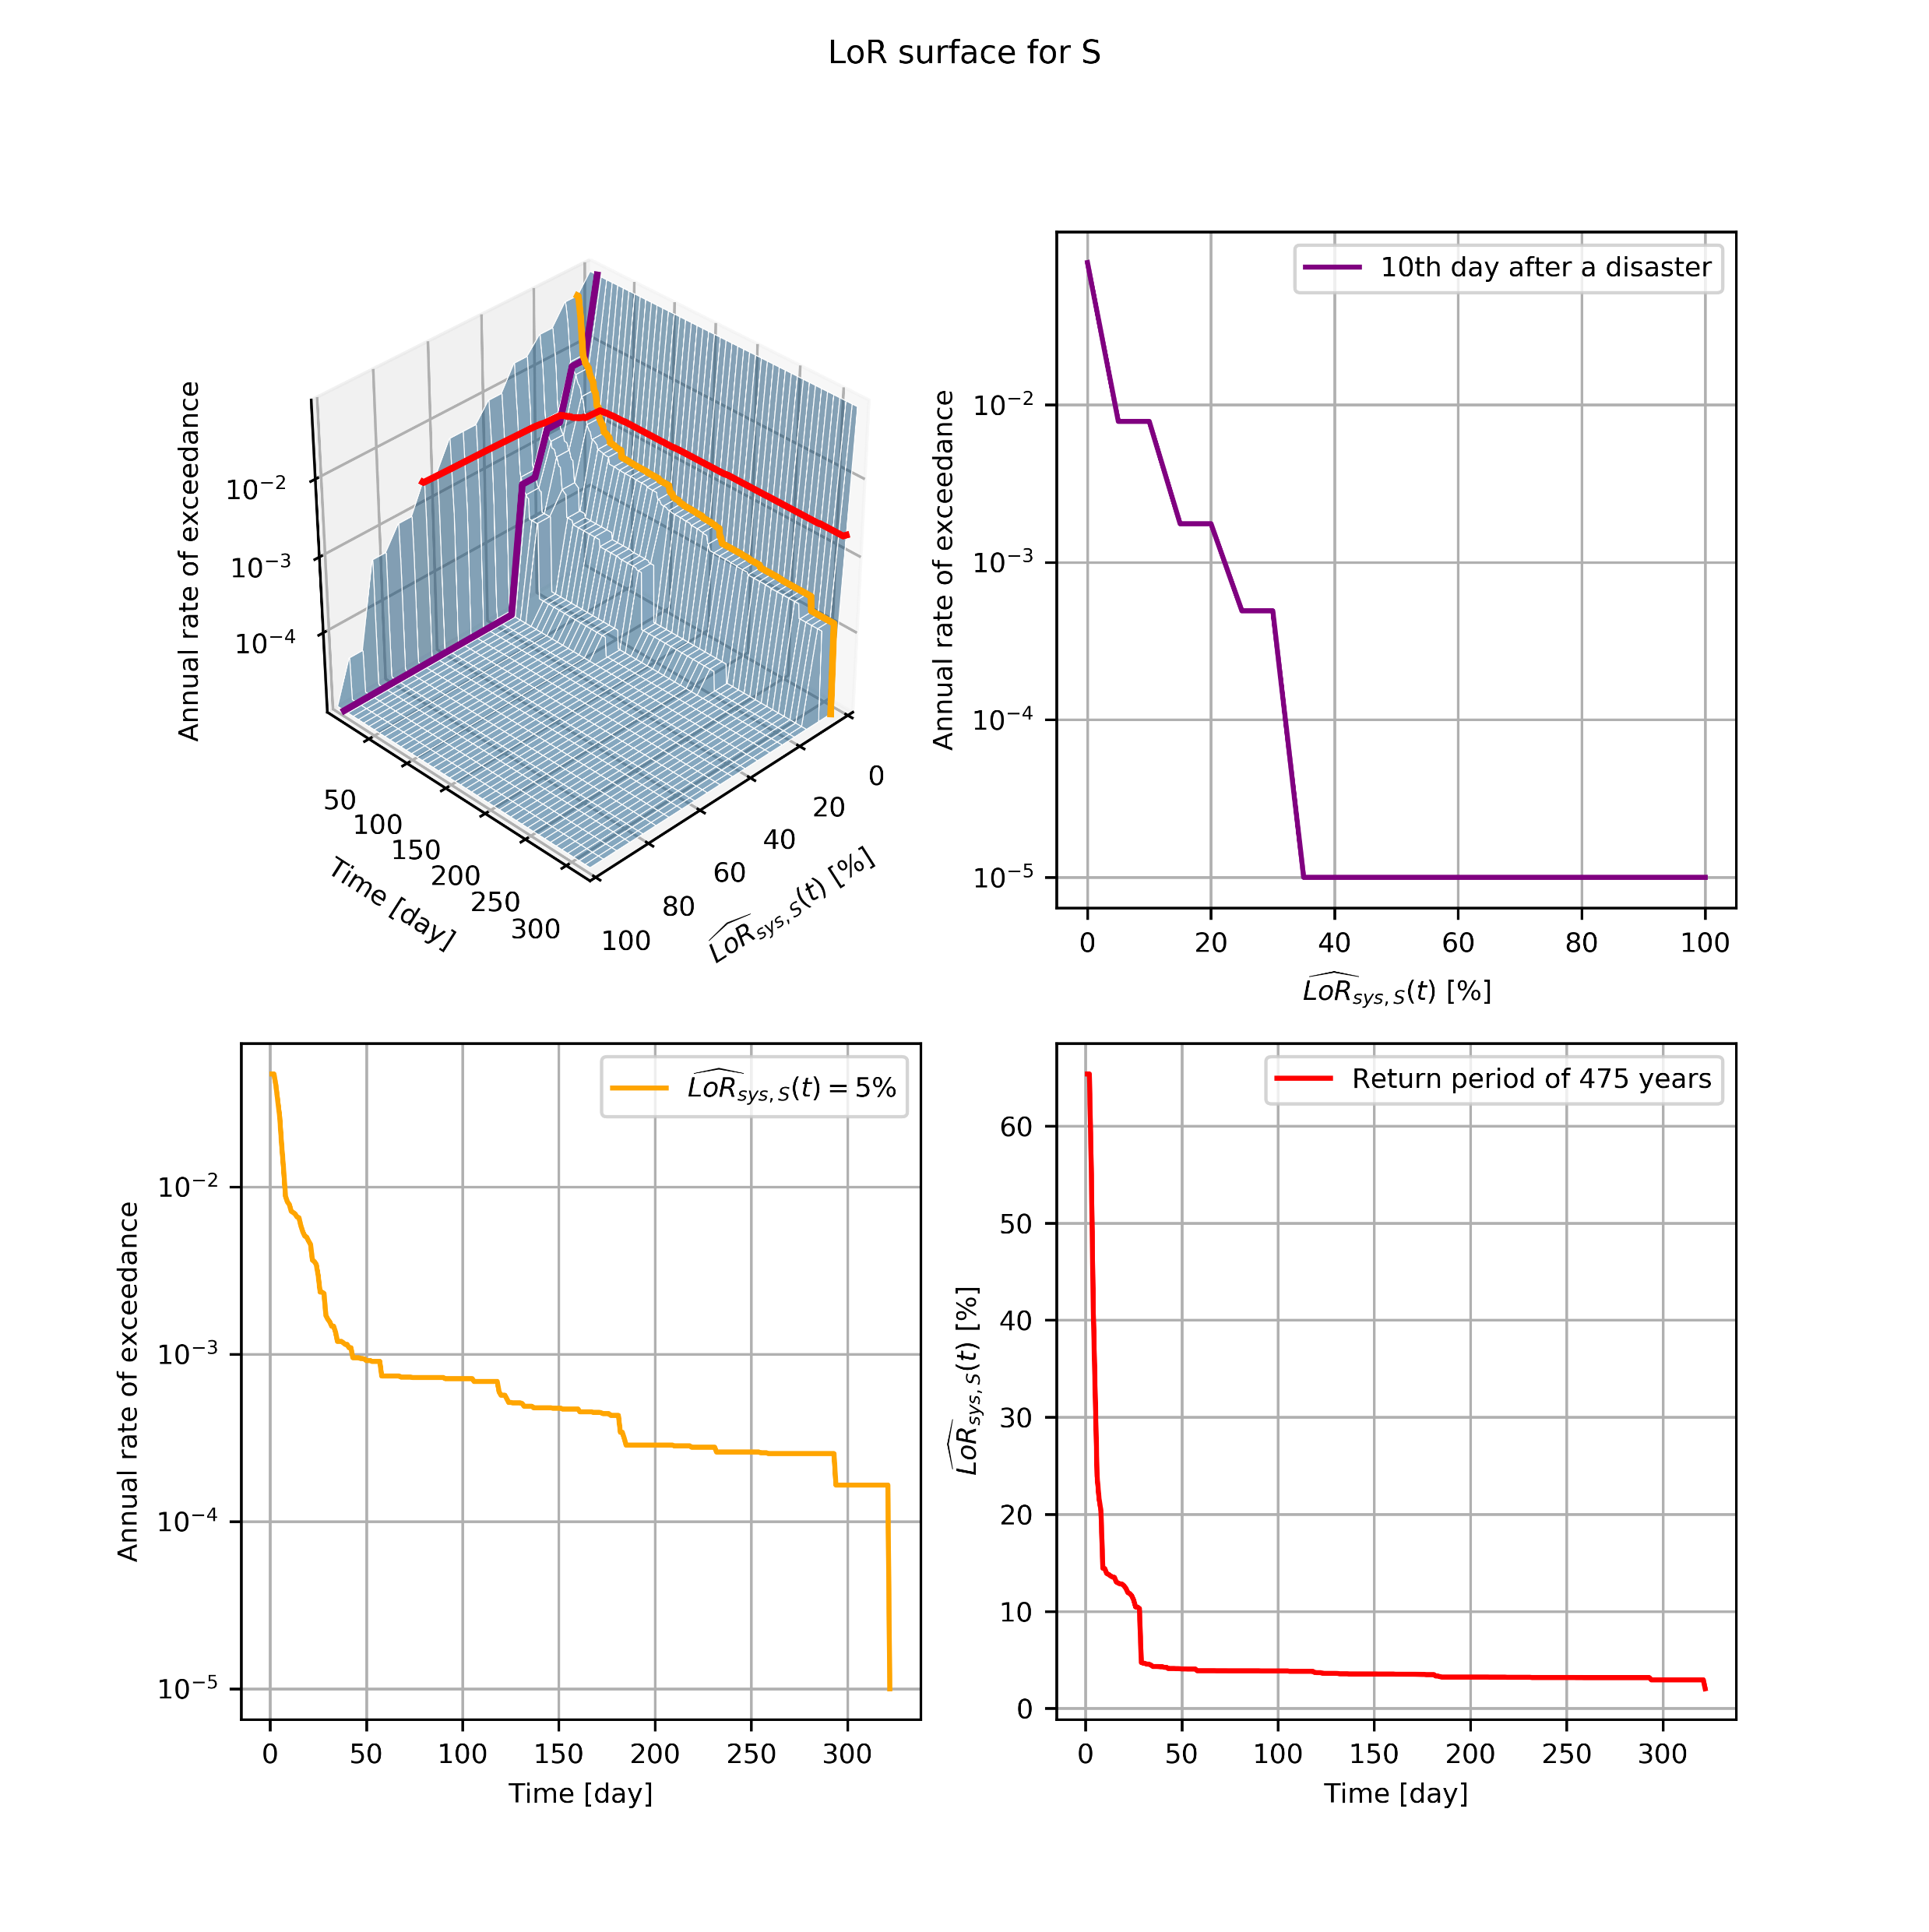

Slide 6
pyrecodes
pyrecodes
pyrecodes

Slide 7
OLD SLIDES

Slide 8
What is resilience?
Disruption
Resilient
Functionality
Not so resilient
Time

Slide 9

How to assess the resilience of a system?
https://www.pinterest.ch/

Slide 10
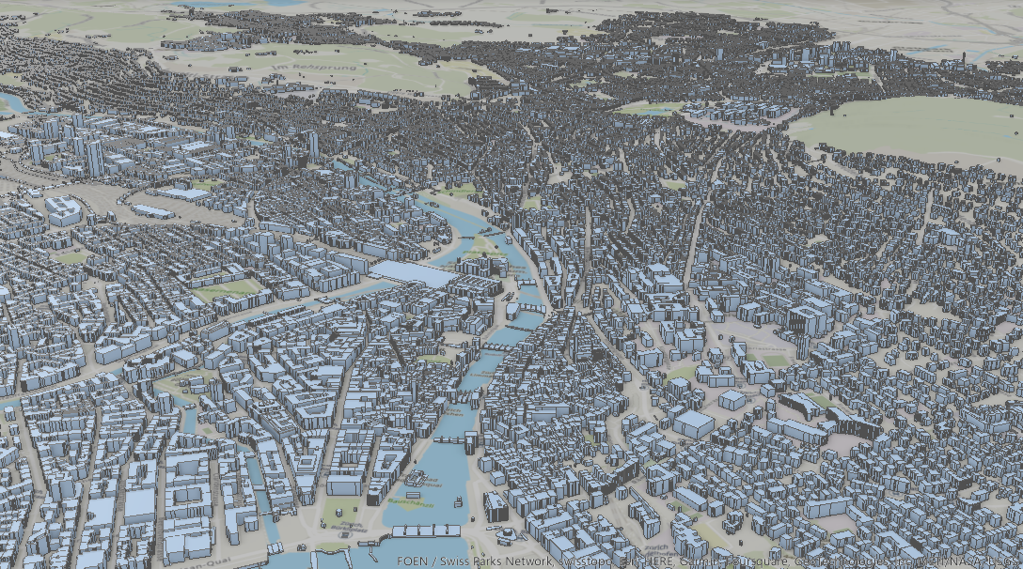
iRe-CoDeS framework: Discretize the system into components
Blagojević, Hefti, Henken, Didier, Stojadinović (2022) Quantifying Disaster Resilience of a Community with Interdependent Civil Infrastructure Systems. Structure and Infrastructure Engineering.

Slide 11
Monitor/simulate components‘ resource supply and demand during recovery
Supply
Supply
Demand
Demand
Supply
Supply
Demand
Demand
Supply
Demand
Supply
Demand
Supply
Demand
Supply
Supply
Demand
Demand
Blagojević, Hefti, Henken, Didier, Stojadinović (2022) Quantifying Disaster Resilience of a Community with Interdependent Civil Infrastructure Systems. Structure and Infrastructure Engineering.

Slide 12
Component‘s post-disaster performance
Component‘s post-disaster supply/demand dynamics characterized using two parameters:
Initial Damage Level – from 0 (no damage) to 1 (complete damage)
Repair Rate – from 0 (no repair) to 1 (complete repair within one time step)
Supply
Damage Level
Initial Damage level
Repair Rate
Demand
Time
Component
Time
Blagojević, Hefti, Henken, Didier, Stojadinović (2022) Quantifying Disaster Resilience of a Community with Interdependent Civil Infrastructure Systems. Structure and Infrastructure Engineering.

Slide 13
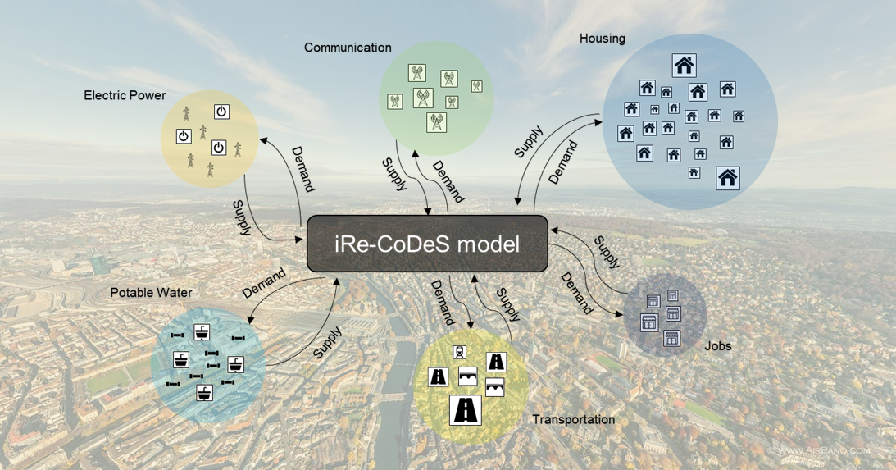
Component interdependencies simulated as a flow of resources and services
Resource distribution models
Blagojević, Hefti, Henken, Didier, Stojadinović (2022) Quantifying Disaster Resilience of a Community with Interdependent Civil Infrastructure Systems. Structure and Infrastructure Engineering.

Slide 14
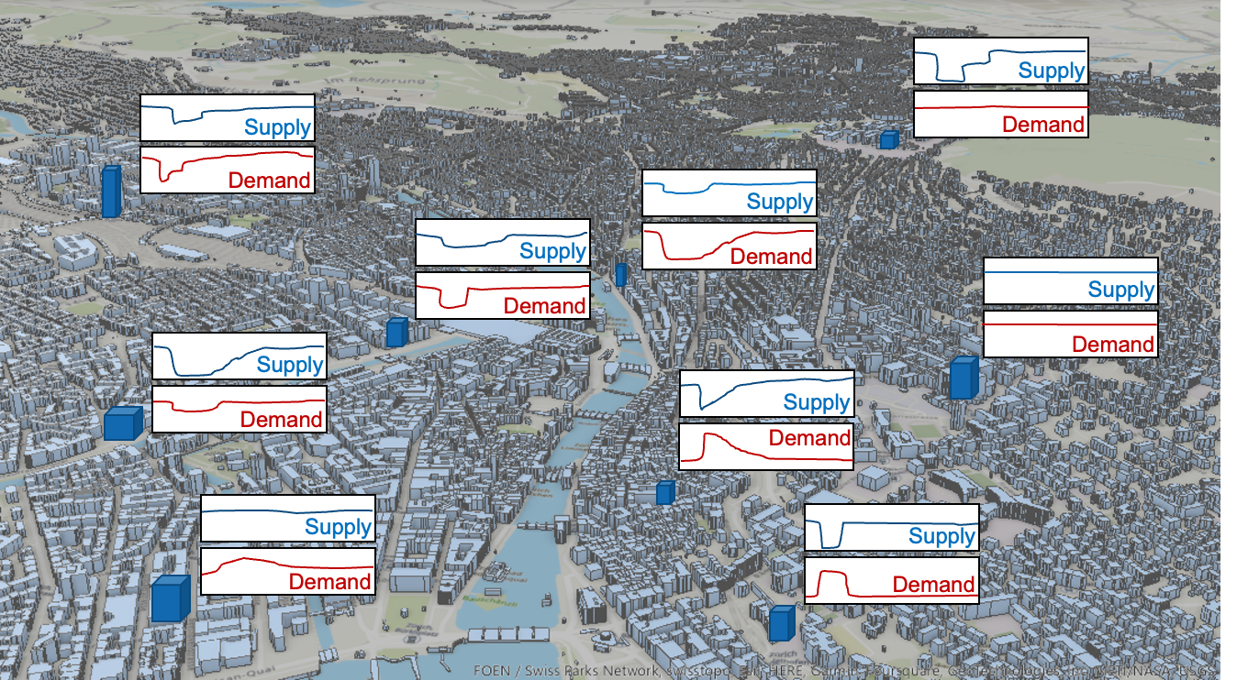
Component interdependencies simulated as a flow of resources and services
Resource distribution models
Blagojević, Hefti, Henken, Didier, Stojadinović (2022) Quantifying Disaster Resilience of a Community with Interdependent Civil Infrastructure Systems. Structure and Infrastructure Engineering.

Slide 15
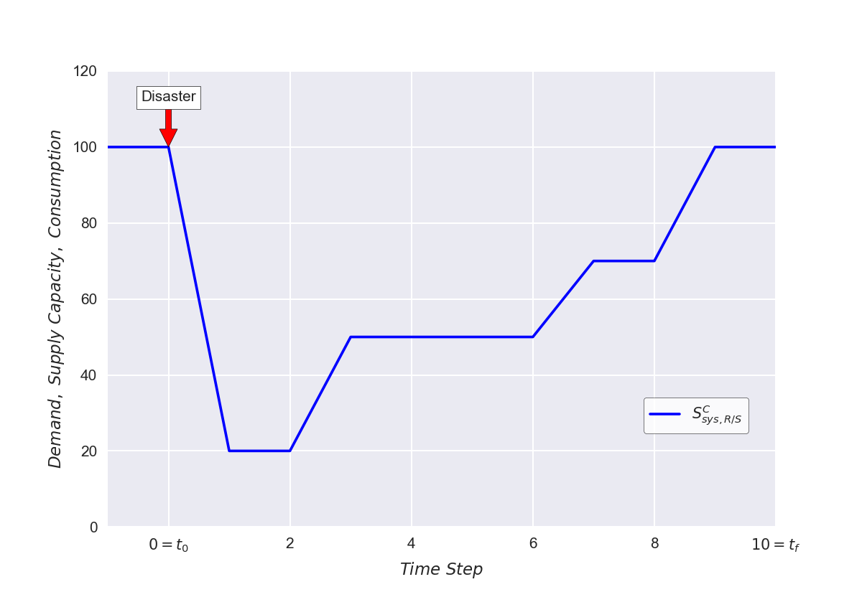
Resilience assessment using system’s supply/demand/consumption
Disaster Resilience Quantification:
System Supply:
Post-disaster demand, supply and consumption of a system during recovery.
Didier, Broccardo, Esposito, Stojadinović (2018) A compositional demand/supply framework to quantify the resilience of civil infrastructure systems (Re-CoDeS). Sustainable and Resilient Infrastructure.

Slide 16
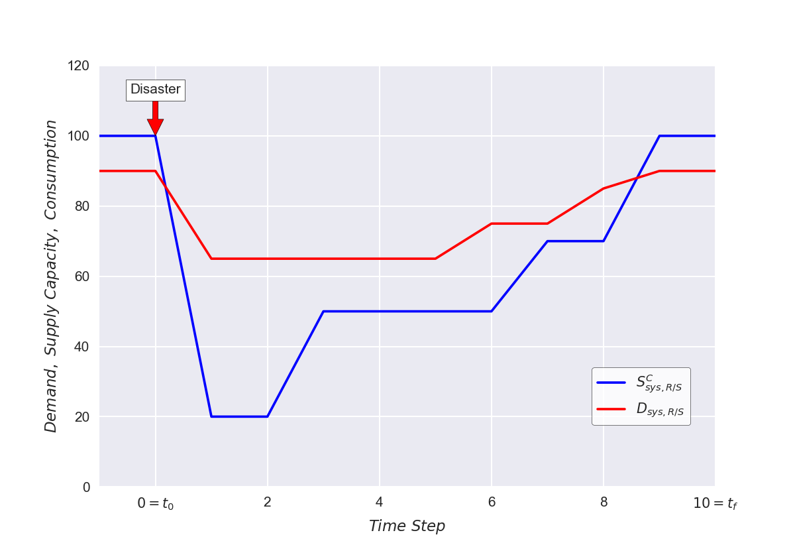
Resilience assessment using system’s supply/demand/consumption
Disaster Resilience Quantification:
System Supply:
System Demand:
Post-disaster demand, supply and consumption of a system during recovery.
Didier, Broccardo, Esposito, Stojadinović (2018) A compositional demand/supply framework to quantify the resilience of civil infrastructure systems (Re-CoDeS). Sustainable and Resilient Infrastructure.

Slide 17
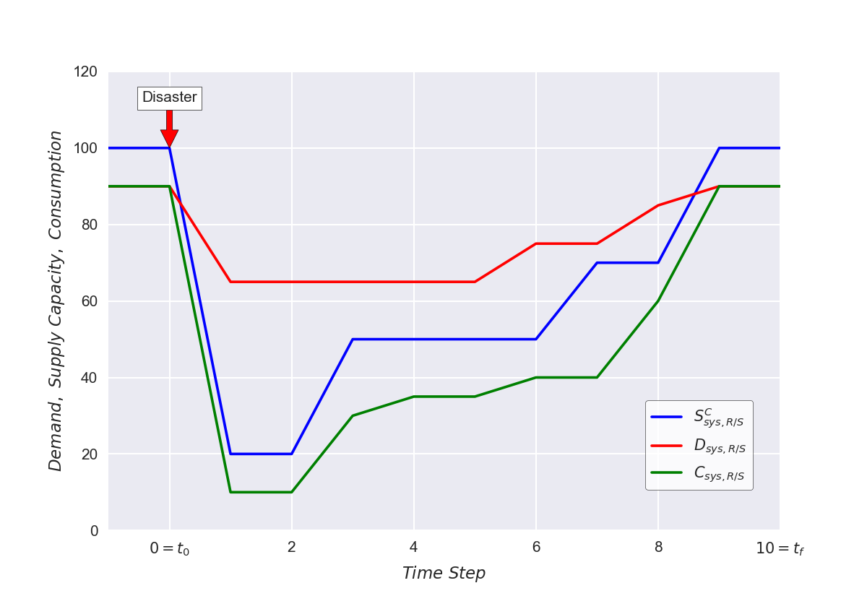
Resilience assessment using system’s supply/demand/consumption
Disaster Resilience Quantification:
System Supply:
System Demand:
System Consumption:
Post-disaster demand, supply and consumption of a system during recovery.
Didier, Broccardo, Esposito, Stojadinović (2018) A compositional demand/supply framework to quantify the resilience of civil infrastructure systems (Re-CoDeS). Sustainable and Resilient Infrastructure.

Slide 18
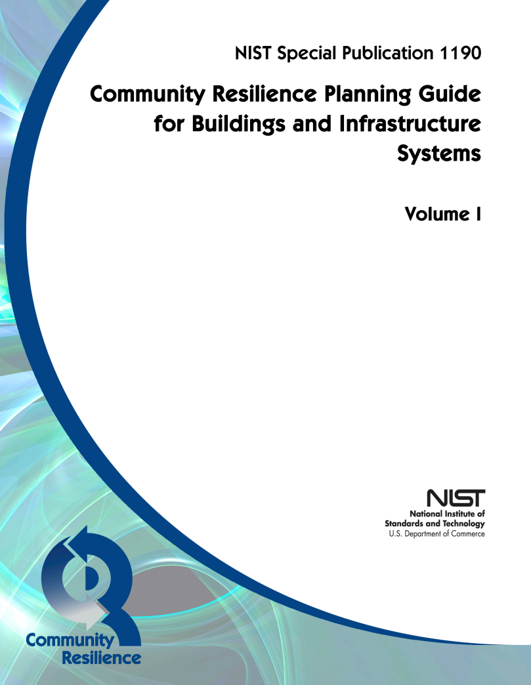
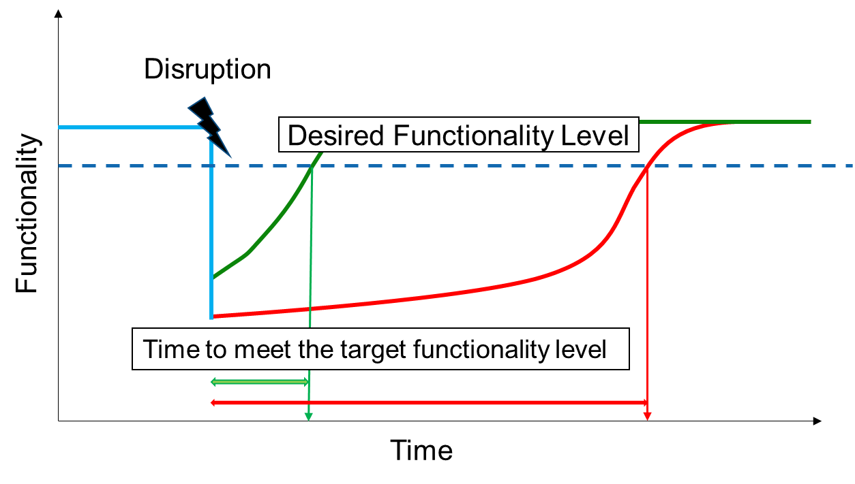
iRe-CoDeS and NIST Community Resilience Goals
Disruption
Desired Functionality Level
Functionality
Time to meet the target functionality level
Time
Unmet demand
Desired percent of met demand
Time to meet the goal
Post-disaster demand, supply and consumption of a system during recovery.
Blagojević, Didier, Stojadinović (2022) Evaluating NIST Community Disaster Resilience Goals using the iRe-CoDeS Resilience Quantification Framework. 12NCEE, Salt Lake City, USA.

Slide 19
How to assess the resilience of a system? + Resilience is often assessed using models that consist of numerous interdependent components and whose performance needs to be understood + getting component data required a lot of effort , and is not possible in some cases due to privacy and security concerns + but some components might be irrelevant for assessing resilience, can we figure out which components those are before we collect data about them? + use sobol indices to rank components using uninformed input distributions + then iteratice heuristic upper and lower bound search to figure out what is irrelevant or what is the span of the distributions if no data available for some components + virtual community whose resilience goals are assessed illustrates the approach + explain iRe-CoDeS – supply/demand, interaction, initial damage level (0 to 1), repair rate (0 to 1)
https://www.pinterest.ch/

Slide 20
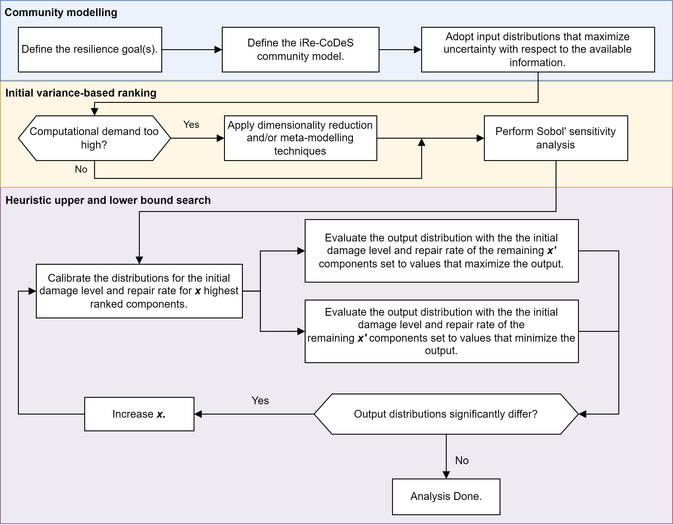
Method for Component Importance Quantification - Step 1
Blagojevic, Didier, Stojadinovic (2022) Quantifying Component Importance for Disaster Resilience of Communities with Interdependent Civil Infrastructure Systems. Reliability Engineering and System Safety

Slide 21
Method for Component Importance Quantification - Step 2
Blagojevic, Didier, Stojadinovic (2022) Quantifying Component Importance for Disaster Resilience of Communities with Interdependent Civil Infrastructure Systems. Reliability Engineering and System Safety

Slide 22
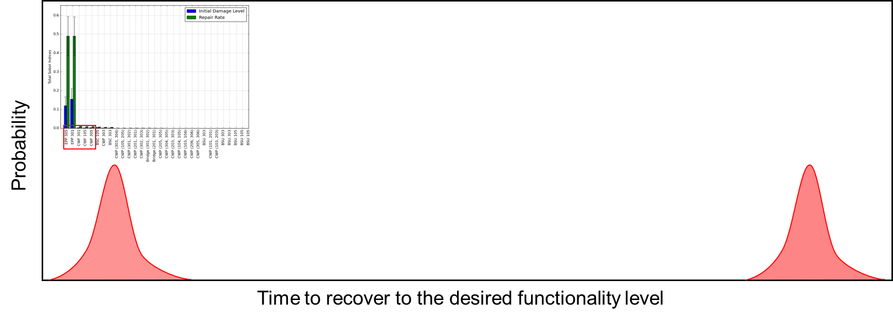
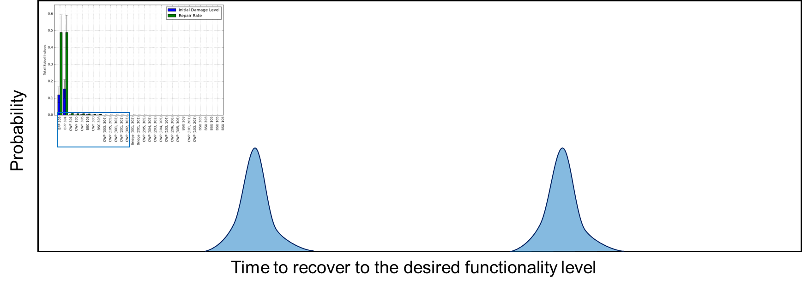
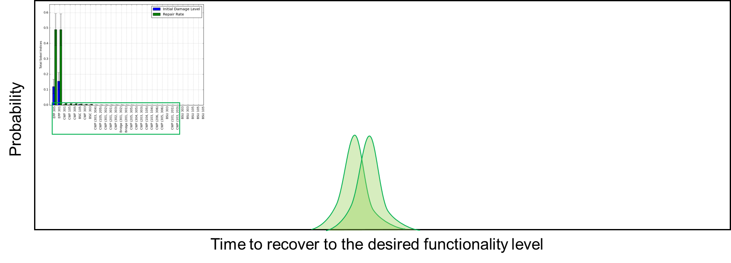
Method for Component Importance Quantification - Step 3
Iteration 1
Iteration 2
Iteration 3
Blagojevic, Didier, Stojadinovic (2022) Quantifying Component Importance for Disaster Resilience of Communities with Interdependent Civil Infrastructure Systems. Reliability Engineering and System Safety

Slide 23
iRe-CoDeS community resilience quantification and the Sobol’ method
Iteration 1
Iteration 2
Iteration 3
Blagojevic, Didier, Stojadinovic (2022) Quantifying Component Importance for Disaster Resilience of Communities with Interdependent Civil Infrastructure Systems. Reliability Engineering and System Safety

Slide 24
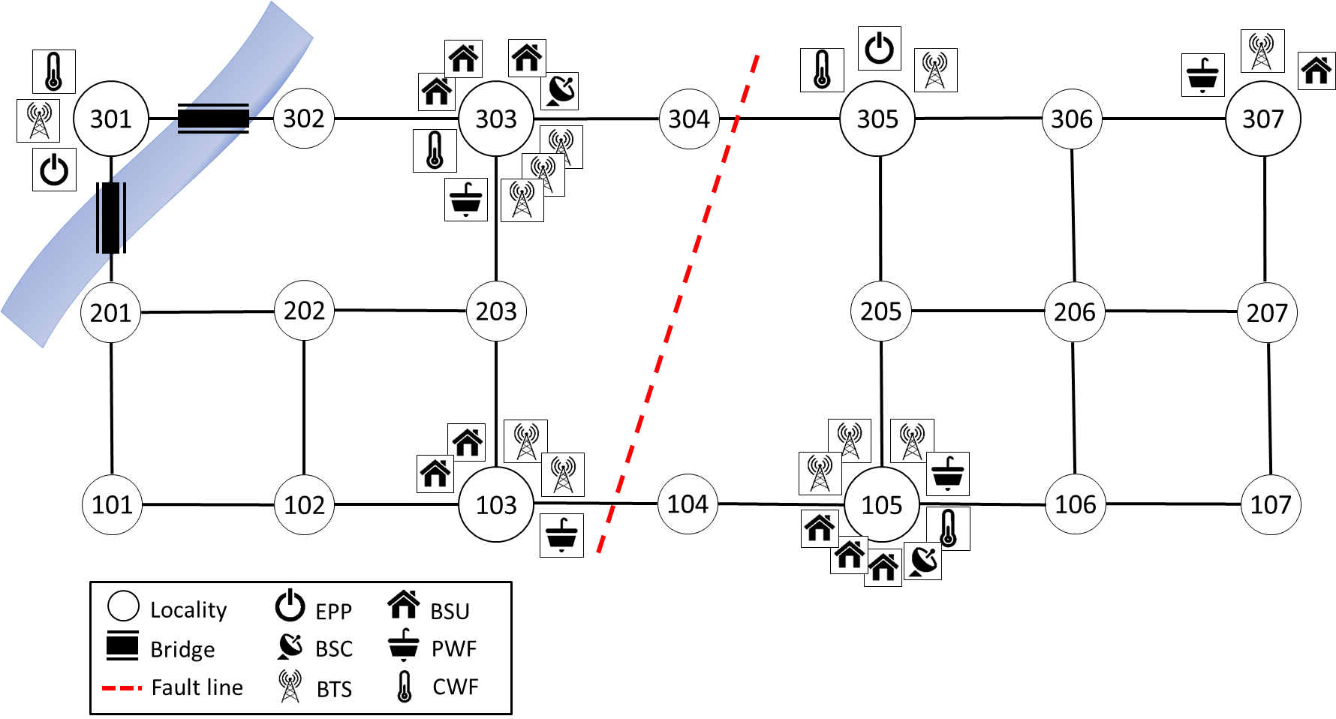
Case Study: Virtual Community with interdependent infrastructure
Resilience Assessment
Motivation

Slide 25
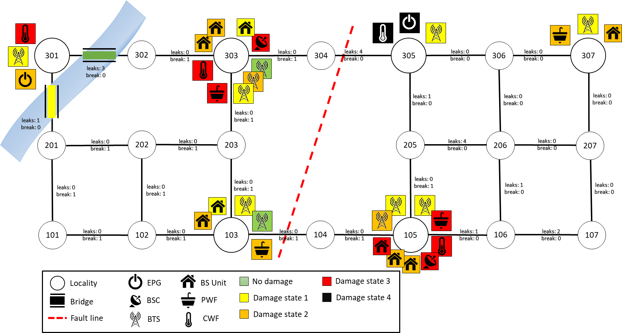
Case Study: Scenario Earthquake
Hazard module
Vulnerability module
Resilience Assessment
Spatial distribution of the PGA for the considered scenario earthquake - hazard module output
Initial damage state of the virtual community due to the scenario earthquake (t=0) – vulnerability module output
Motivation
Blagojević, Kipfer, Didier, Stojadinović (2020) Scenario-based Resilience Assessment of Communities with Interdependent Civil Infrastructure Systems. Proceeding of the 17th World Conference on Earthquake Engineering. Sendai, Japan.

Slide 26
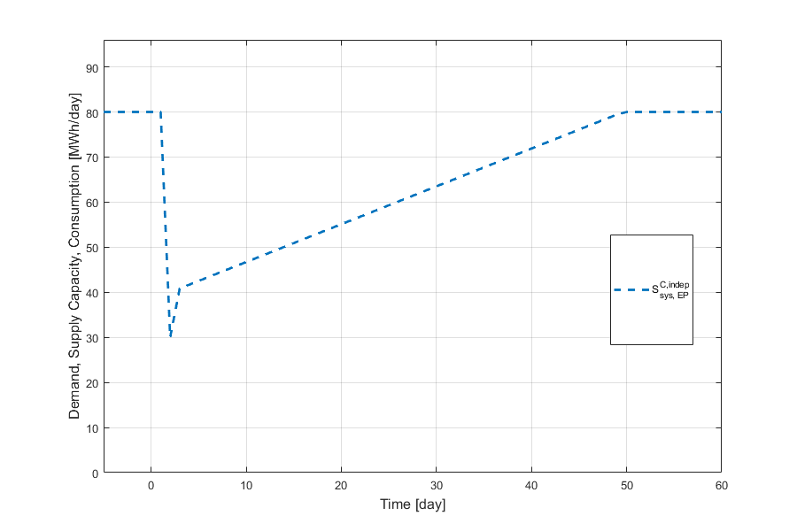
Case Study: Assessing infastructure resilience to a scenario earthquake
Recovery of electric power supply without considering electric power plants’ dependance on other systems
Resilience Assessment
Motivation
Blagojević, Kipfer, Didier, Stojadinović (2020) Scenario-based Resilience Assessment of Communities with Interdependent Civil Infrastructure Systems. Proceeding of the 17th World Conference on Earthquake Engineering. Sendai, Japan.

Slide 27
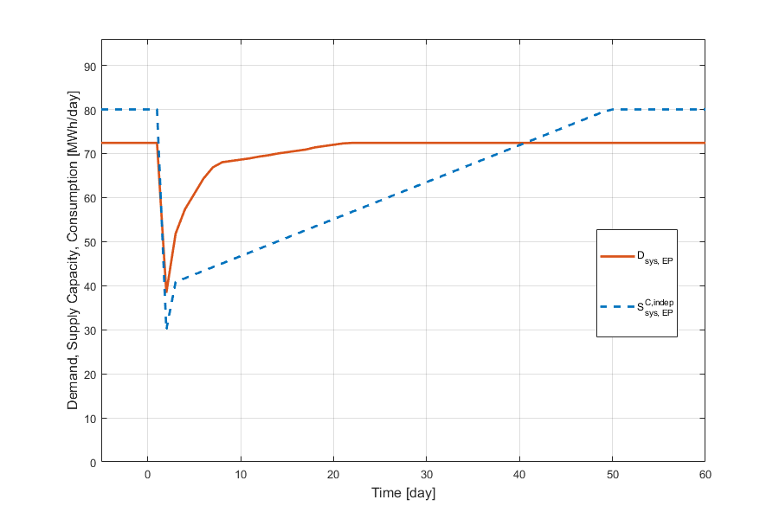
Case Study: Assessing infastructure resilience to a scenario earthquake
Post-disaster change in electric power demand as people leave and return to buildings
Resilience Assessment
Motivation
Blagojević, Kipfer, Didier, Stojadinović (2020) Scenario-based Resilience Assessment of Communities with Interdependent Civil Infrastructure Systems. Proceeding of the 17th World Conference on Earthquake Engineering. Sendai, Japan.

Slide 28
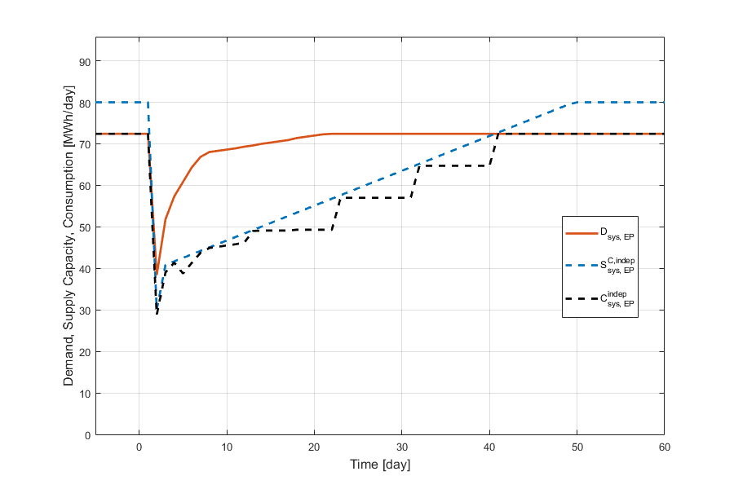
Case Study: Assessing infastructure resilience to a scenario earthquake
Recovery of electric power consumption
Resilience Assessment
Motivation
Blagojević, Kipfer, Didier, Stojadinović (2020) Scenario-based Resilience Assessment of Communities with Interdependent Civil Infrastructure Systems. Proceeding of the 17th World Conference on Earthquake Engineering. Sendai, Japan.

Slide 29
Resilience assessment using system’s supply/demand/consumption
Disaster Resilience Quantification:
System Supply:
System Demand:
System Consumption:
Resilience Metric:
Post-disaster demand, supply and consumption of a system during recovery.
Didier, Broccardo, Esposito, Stojadinović (2018) A compositional demand/supply framework to quantify the resilience of civil infrastructure systems (Re-CoDeS). Sustainable and Resilient Infrastructure.

Slide 30
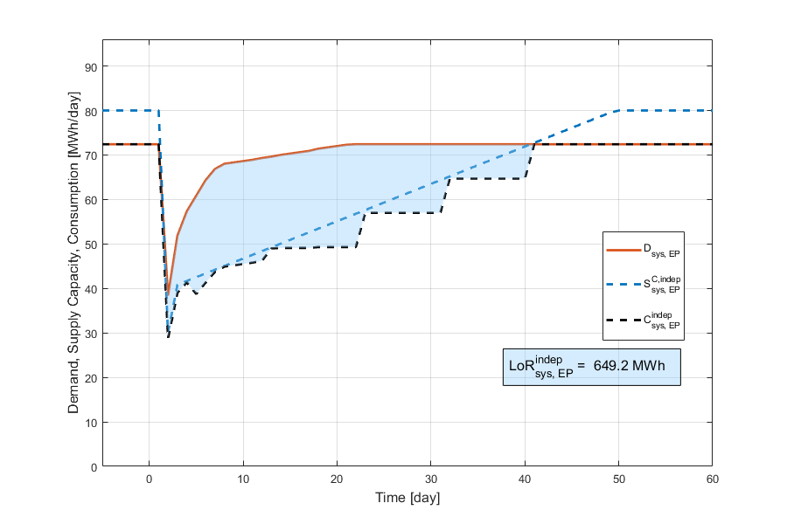
Case Study: Assessing infastructure resilience to a scenario earthquake
Total unmet demand (LoR) for electric power over the recovery period is 649.2MWh without considering system interdependencies.
Resilience Assessment
Motivation
Blagojević, Kipfer, Didier, Stojadinović (2020) Scenario-based Resilience Assessment of Communities with Interdependent Civil Infrastructure Systems. Proceeding of the 17th World Conference on Earthquake Engineering. Sendai, Japan.

Slide 31
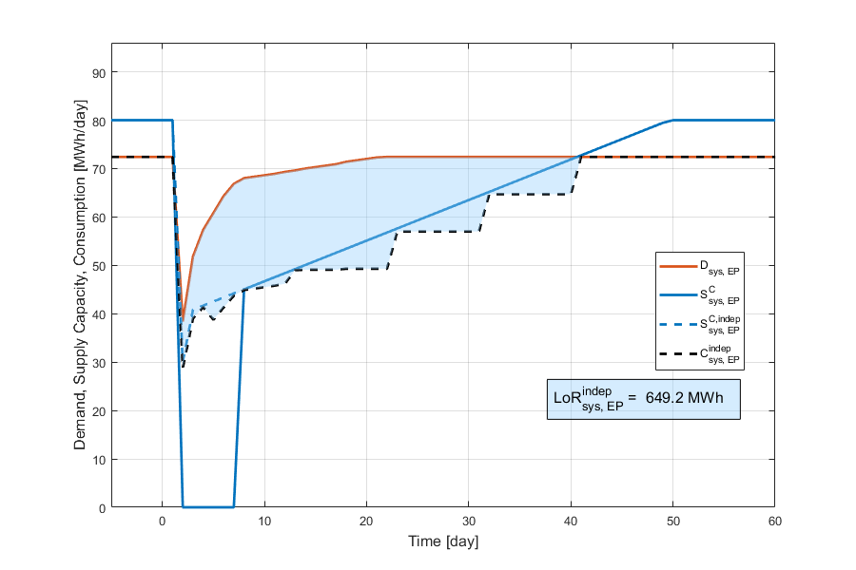
Case Study: Assessing infastructure resilience to a scenario earthquake
Recovery of electric power supply considering electric power plants’ dependance on cooling water and communication services.
Resilience Assessment
Reduction in electric power supply during first 9 post-disaster days due to interdependency effects
Motivation
Blagojević, Kipfer, Didier, Stojadinović (2020) Scenario-based Resilience Assessment of Communities with Interdependent Civil Infrastructure Systems. Proceeding of the 17th World Conference on Earthquake Engineering. Sendai, Japan.

Slide 32
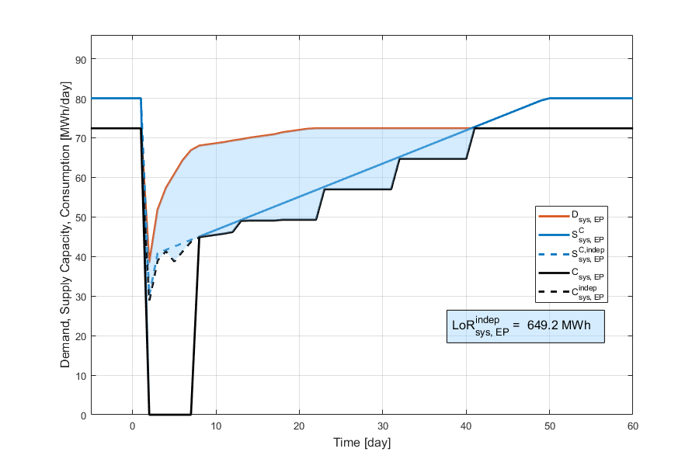
Case Study: Assessing infastructure resilience to a scenario earthquake
Recovery of electric power consumption considering electric power plants’ dependance on cooling water and communication services.
Resilience Assessment
Reduction in electric power consumption during first 9 post-disaster days due to interdependency effects
Motivation
Blagojević, Kipfer, Didier, Stojadinović (2020) Scenario-based Resilience Assessment of Communities with Interdependent Civil Infrastructure Systems. Proceeding of the 17th World Conference on Earthquake Engineering. Sendai, Japan.

Slide 33
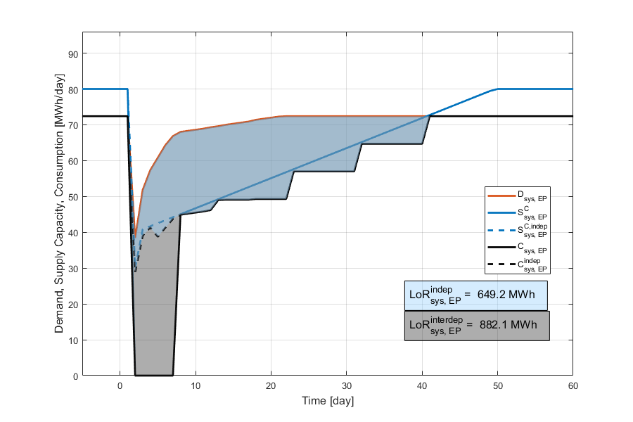
Case Study: Assessing infastructure resilience to a scenario earthquake
Total unmet demand (LoR) for electric power over the recovery period is 882.1MWh considering system interdependencies.
Resilience Assessment
Motivation
Blagojević, Kipfer, Didier, Stojadinović (2020) Scenario-based Resilience Assessment of Communities with Interdependent Civil Infrastructure Systems. Proceeding of the 17th World Conference on Earthquake Engineering. Sendai, Japan.

Slide 34
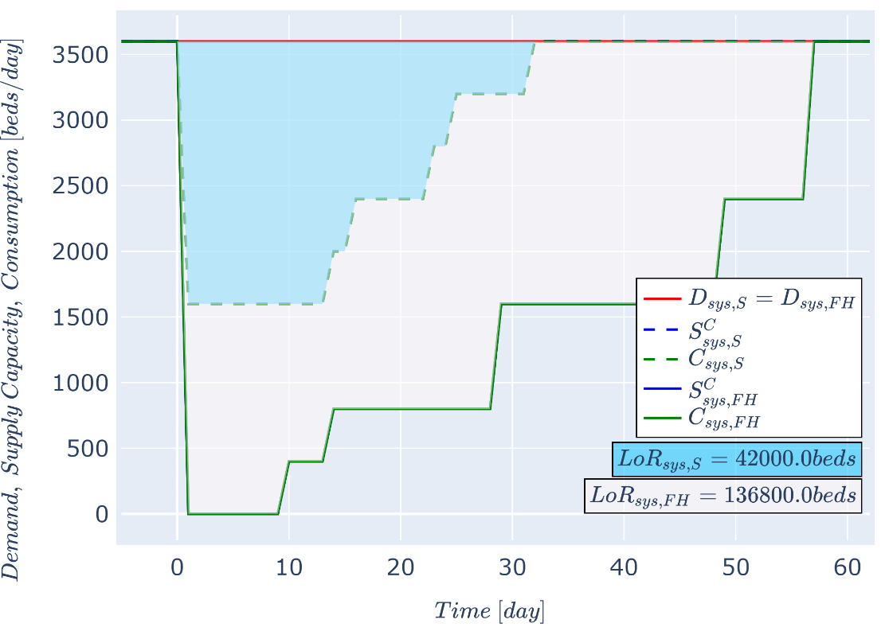
Case Study: Assessing housing resilience to a scenario earthquake
Housing resilience assessment consistent with infrastructure resilience assessment: simulate housing supply/demand/consumption over the recovery period.
Resilience Assessment
Motivation
Blagojević, Lauber, Didier, Stojadinović (2022) Evaluating the Importance of Interdependent Civil Infrastructure System Components for Disaster Resilience of Community Housing. Lifelines 2022, Los Angeles, USA.

Slide 35
Resilience Assessment of the Built Environment Recovery modelling in iRe-CoDeS

Slide 36
How resilient do we need to be? Defining the desired community performance
Disruption
Desired Functionality Level
Functionality
Resilience Assessment
Time to meet the target functionality level
Motivation
Time
NIST (2016) Community Resilience Planning Guide for Buildings and Infrastructure Systems. NIST Special Publication 1190.

Slide 37
Resilience assessment using system’s supply/demand/consumption
Disaster Resilience Quantification:
System Supply:
System Demand:
System Consumption:
Resilience Metric:
Resilience Assessment
Post-disaster demand, supply and consumption of a system during recovery.
Motivation
Didier, Broccardo, Esposito, Stojadinović (2018) A compositional demand/supply framework to quantify the resilience of civil infrastructure systems (Re-CoDeS). Sustainable and Resilient Infrastructure.

Slide 38

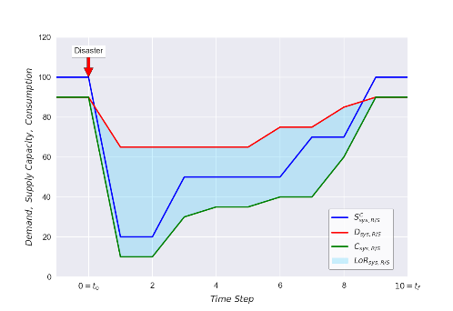
iRe-CoDeS community resilience quantification and the Sobol’ method
The importance of each component’s initial damage level and repair rate is quantified:
INPUTS
COMPUTATIONAL MODEL
OUTPUTS
Resilience Improvement
Component 1
Initial Damage Level
Repair Rate
LoR_{R/S1}
Component 2
Initial Damage Level
iRe-CoDeS community model
Repair Rate
Resilience Assessment
LoR_{R/Sn}
Component i
Initial Damage Level
Repair Rate
Sobol’ method
Motivation
Blagojević, Didier, Stojadinović (2022) Quantifying Component Importance for Disaster Resilience of Communities with Interdependent Civil Infrastructure Systems. Reliability Engineering and System Safety.

Slide 39
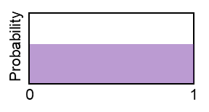
iRe-CoDeS community resilience quantification and the Sobol’ method
Input probability distributions are assumed with no information on components’ vulnerability and recoverability.
INPUTS
COMPUTATIONAL MODEL
OUTPUTS
Resilience Improvement
Component 1
Initial Damage Level
Repair Rate
LoR_{R/S1}
Component 2
Initial Damage Level
iRe-CoDeS community model
Repair Rate
Resilience Assessment
LoR_{R/Sn}
Component i
Initial Damage Level
Repair Rate
Sobol’ method
Probability
Motivation
0
1
Blagojević, Didier, Stojadinović (2022) Quantifying Component Importance for Disaster Resilience of Communities with Interdependent Civil Infrastructure Systems. Reliability Engineering and System Safety.

Slide 40
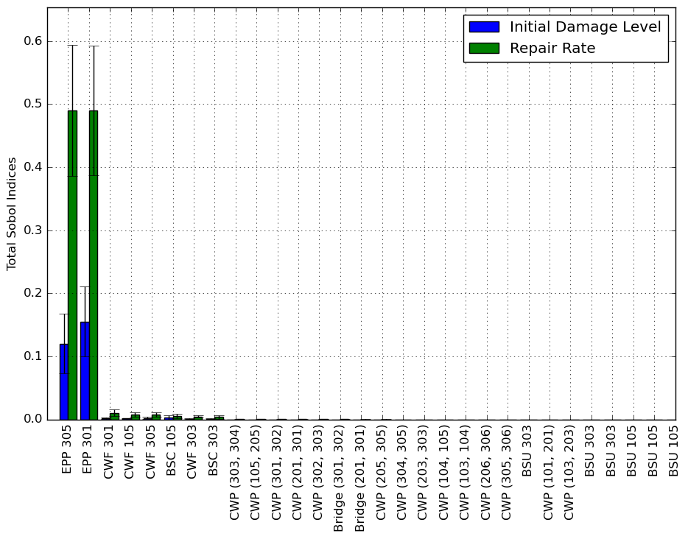
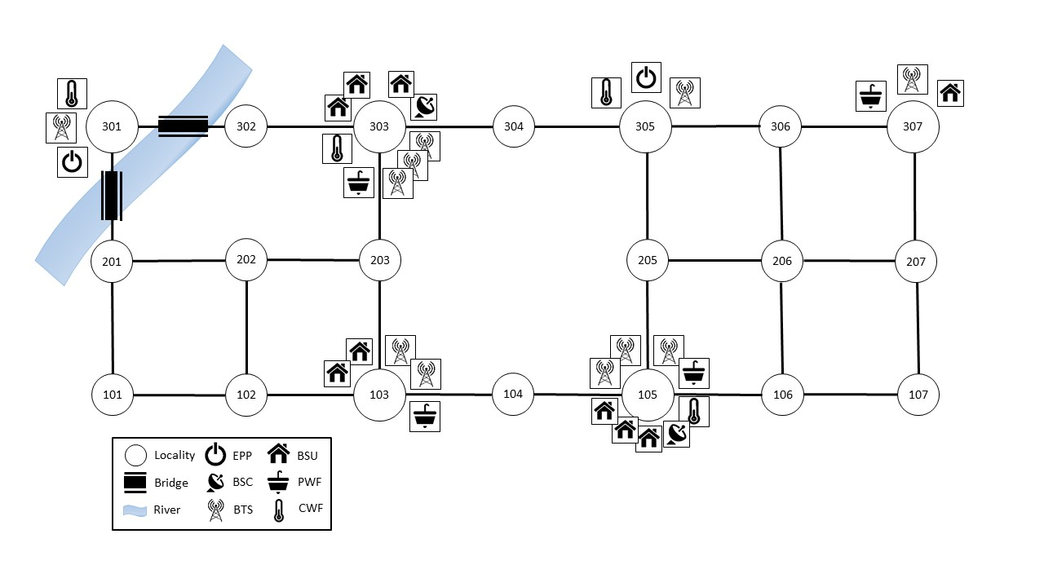
Component Importance for the Electric Power System Resilience
Resilience Improvement
Resilience Assessment
Motivation

Slide 41
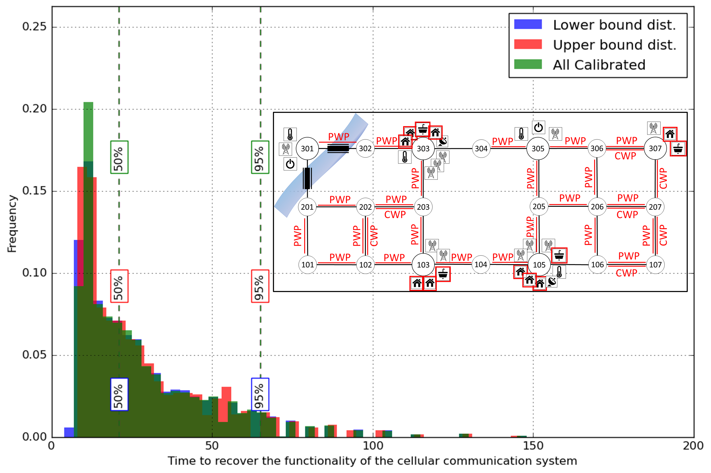
Component Importance for the Communication System Resilience
Probability distributions of the time to meet 90% of demand for communication service without any information on vulnerability and recoverability on half of community components.
Resilience Improvement
Resilience Assessment
Motivation
Blagojević, Didier, Stojadinović (2022) Quantifying Component Importance for Disaster Resilience of Communities with Interdependent Civil Infrastructure Systems. Reliability Engineering and System Safety.
Blagojević, Didier, Stojadinović (2023) Identifying Components Important for System Resilience. ICASP14’, Dublin, Ireland.

Slide 42
Conclusion

Slide 43
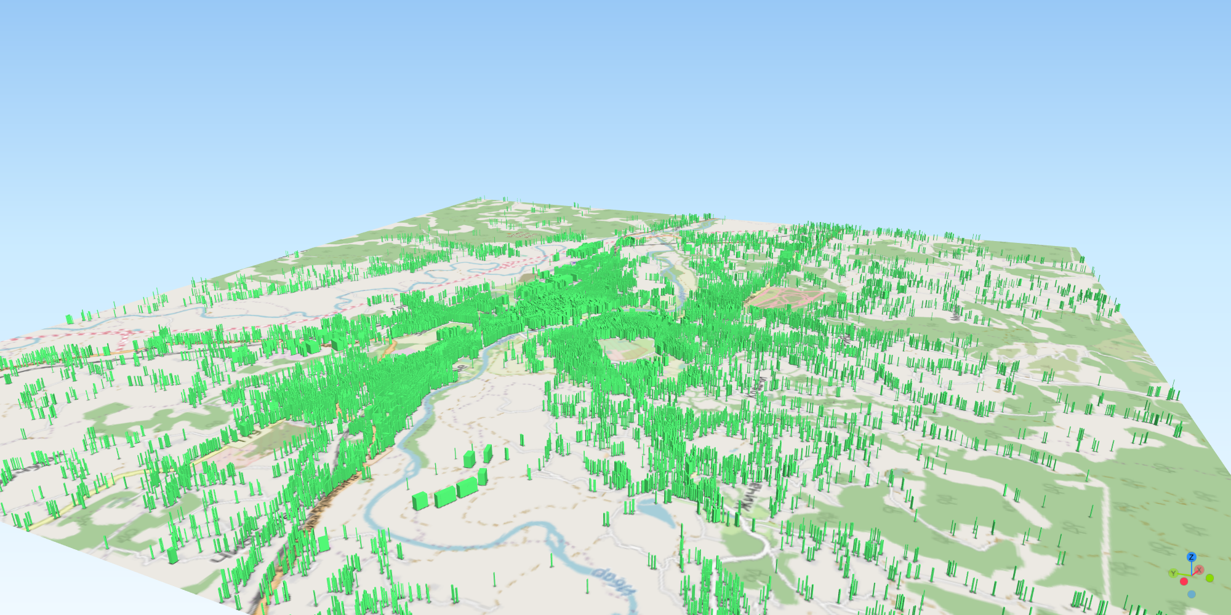
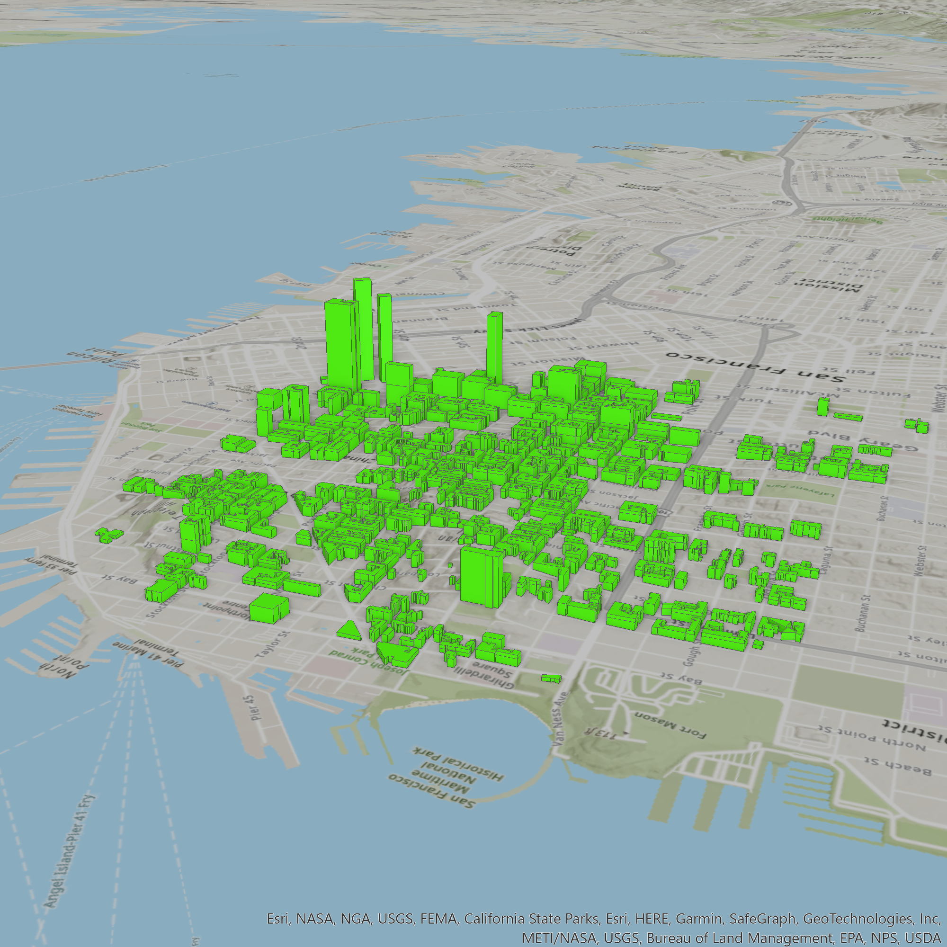
Conclusion
iRe-CoDeS framework provides a foundation for simulating regional recovery and assessing built environment’s resilience:
Bottom-up framework – the effect of building-level interventions on community resilience can be investigated.

Slide 44
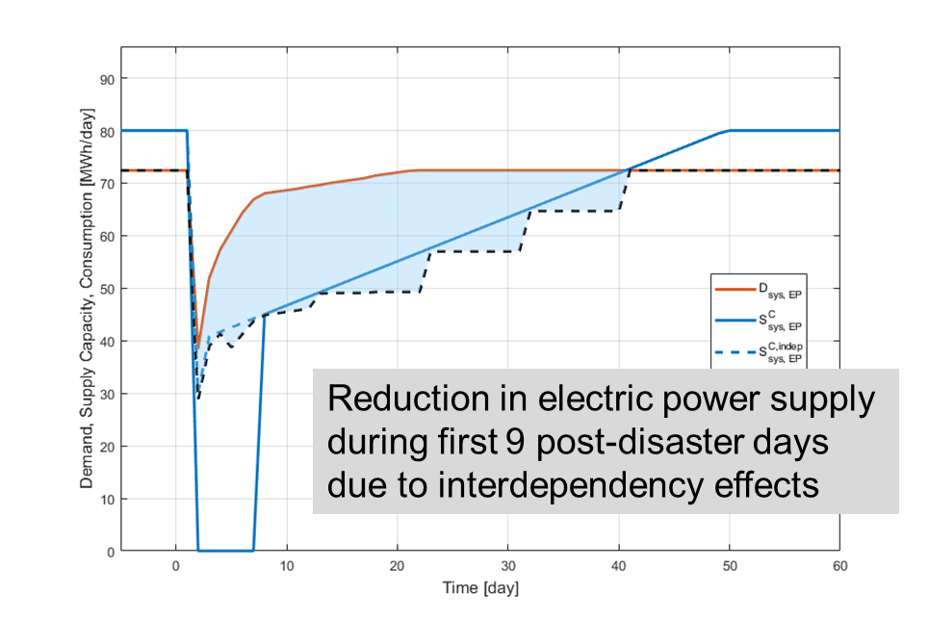
Conclusion
iRe-CoDeS framework provides a foundation for simulating regional recovery and assessing built environment’s resilience:
Bottom-up framework – the effect of building-level interventions on community resilience can be investigated.
Component interaction simulated as a flow of resources – uses existing data on supply/demand and flow models.

Slide 45
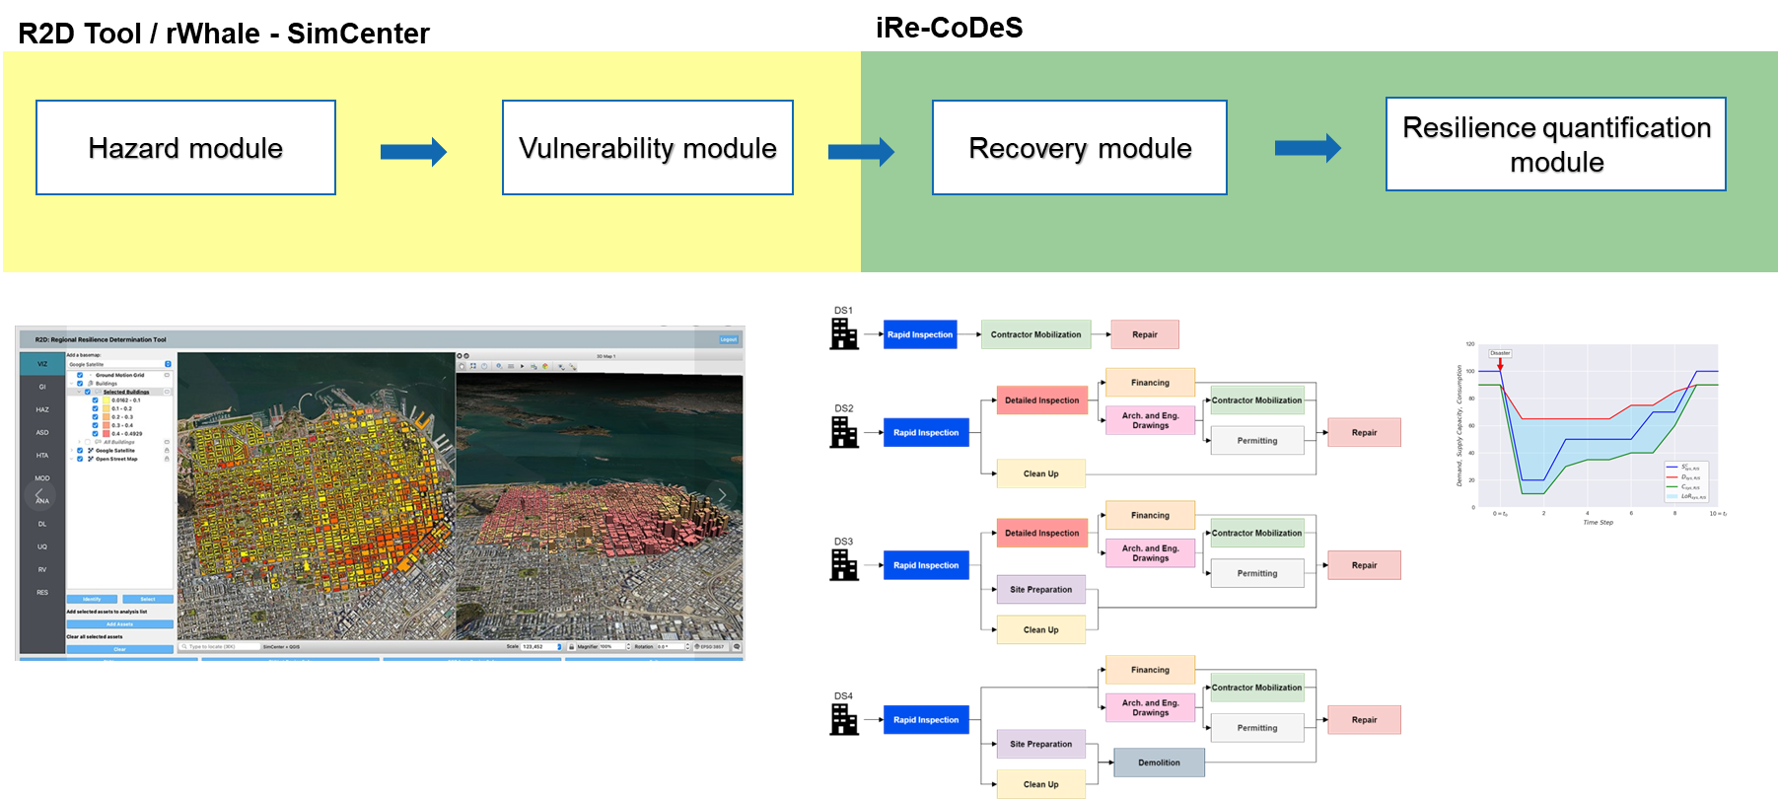
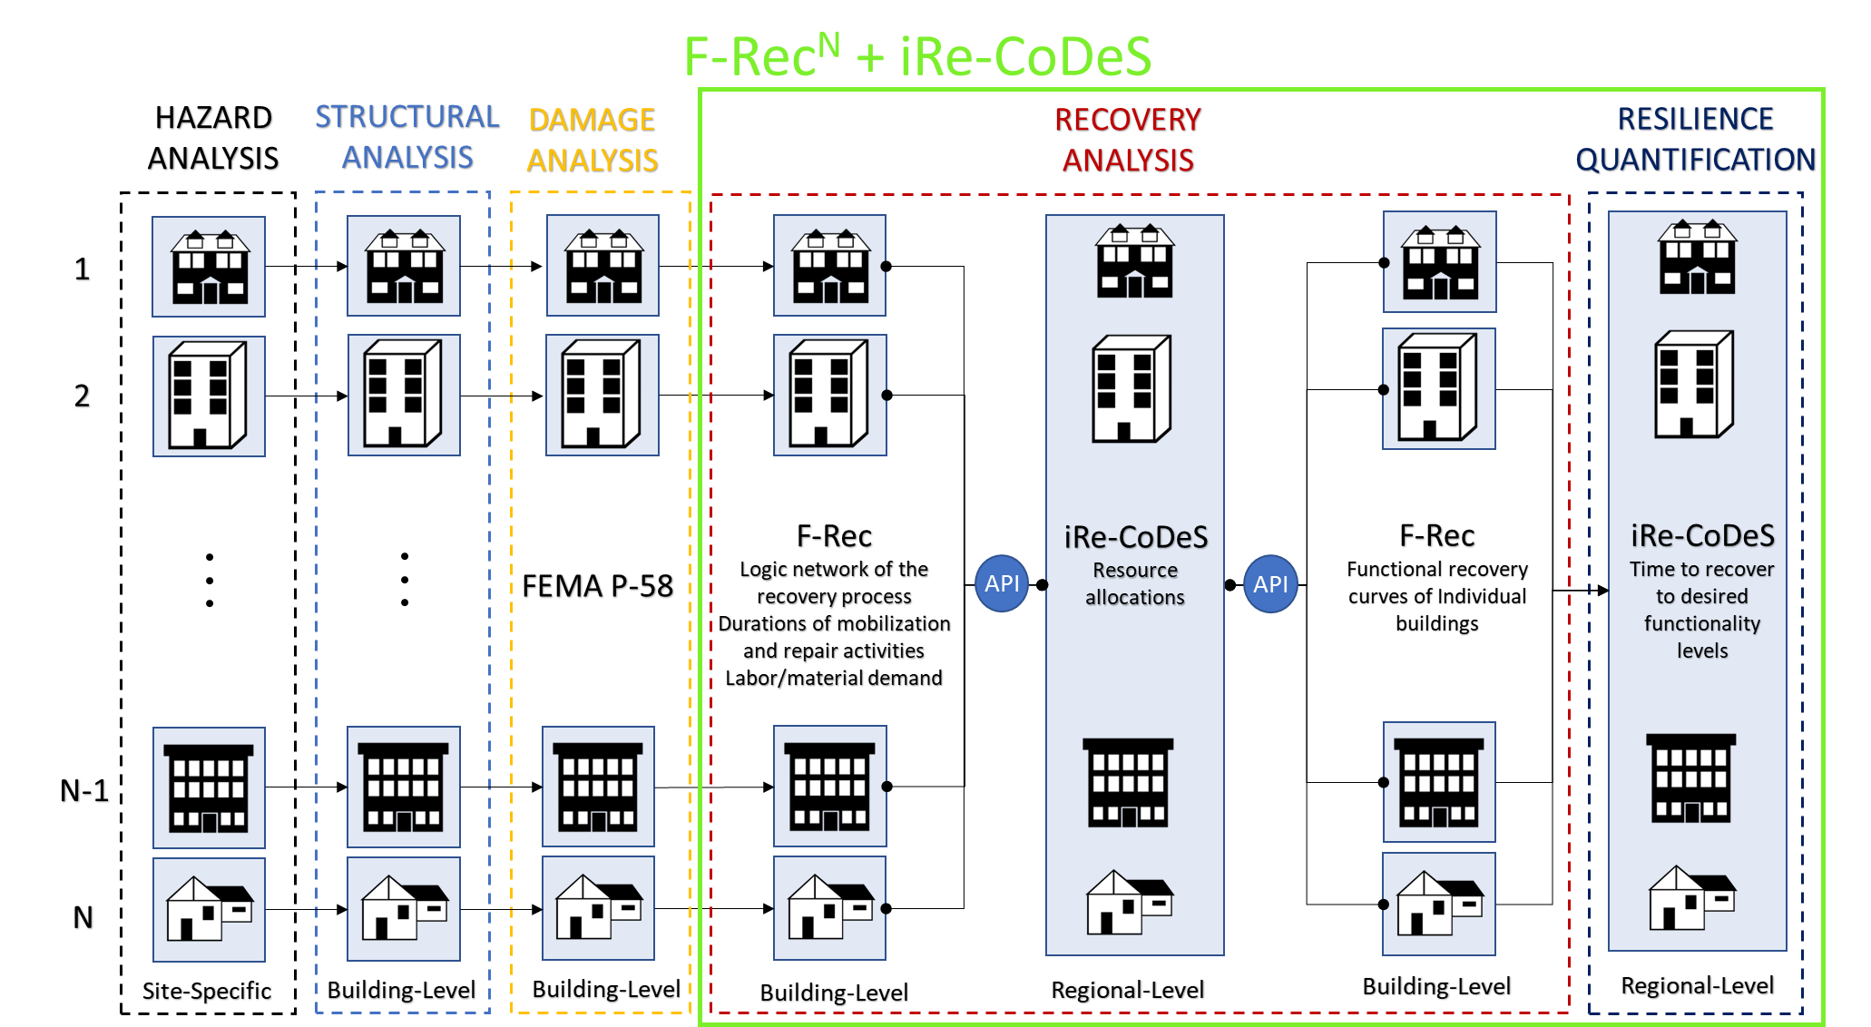
Conclusion
iRe-CoDeS framework provides a foundation for simulating regional recovery and assessing built environment’s resilience:
Bottom-up framework – the effect of building-level interventions on community resilience can be investigated.
Component interaction simulated as a flow of resources – uses existing data on supply/demand and flow models.
Extensible and modular – third-party models can be integrated within the framework.

Slide 46
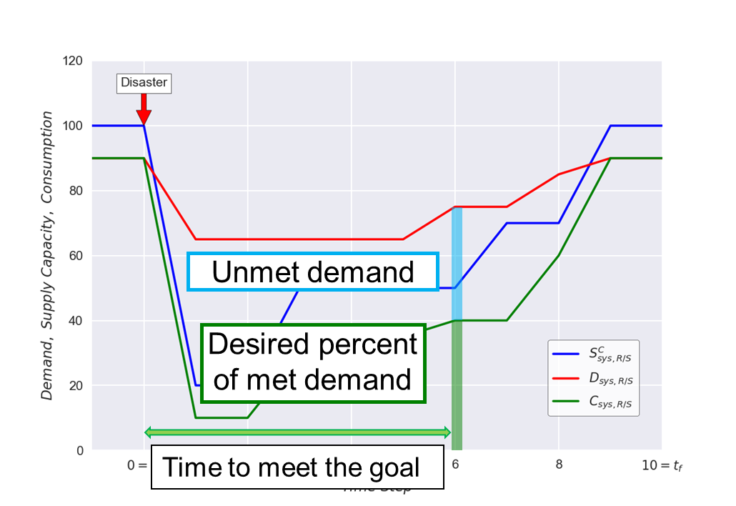
Conclusion
iRe-CoDeS framework provides a foundation for simulating regional recovery and assessing built environment’s resilience:
Bottom-up framework – the effect of building-level interventions on community resilience can be investigated.
Component interaction simulated as a flow of resources – uses existing data on supply/demand and flow models.
Extensible and modular – third-party models can be integrated within the framework.
Can be used for probabilistic assessment of community resilience goals.

Slide 47
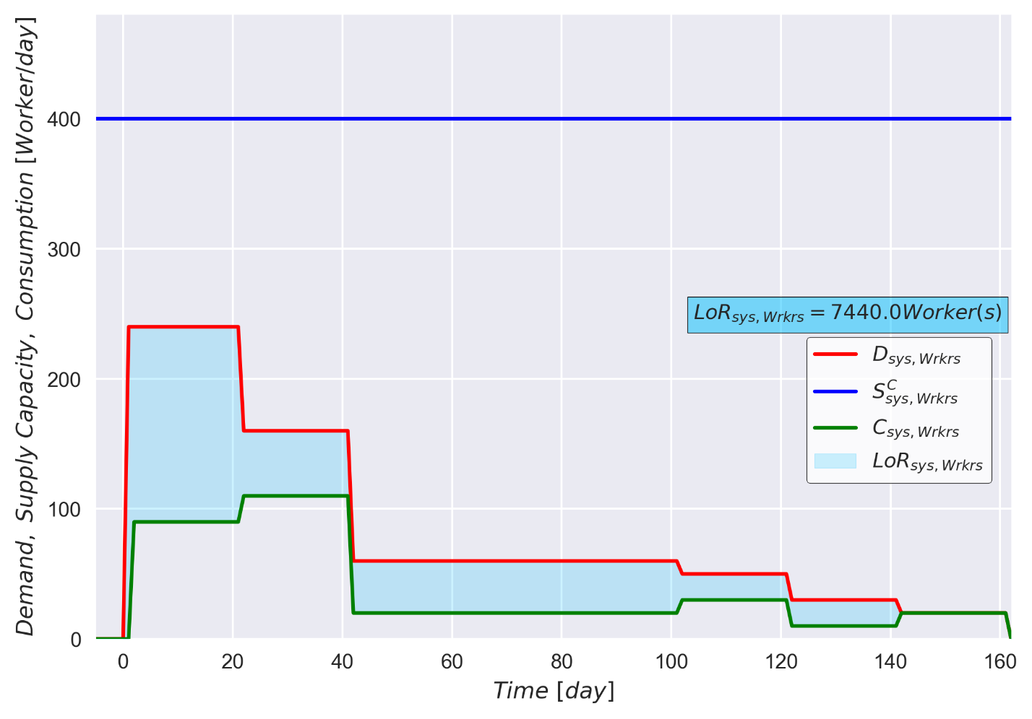
Conclusion
iRe-CoDeS framework provides a foundation for simulating regional recovery and assessing built environment’s resilience:
Bottom-up framework – the effect of building-level interventions on community resilience can be investigated.
Component interaction simulated as a flow of resources – uses existing data on supply/demand and flow models.
Extensible and modular – third-party models can be integrated within the framework.
Can be used for probabilistic assessment of community resilience goals.
Consistent across various subsystems of the built environment.
Electric Power
Housing
Recovery Resources

Slide 48
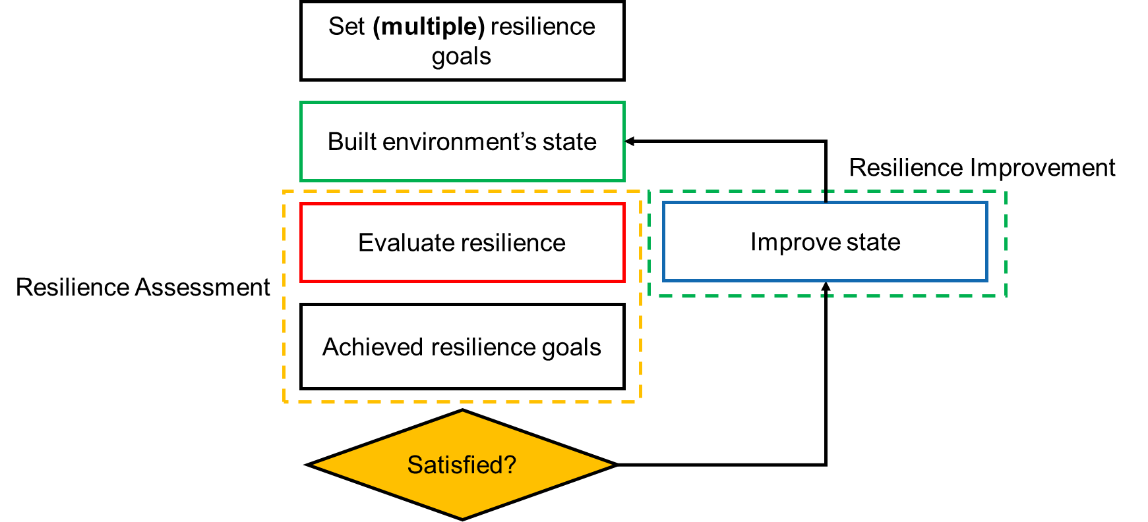
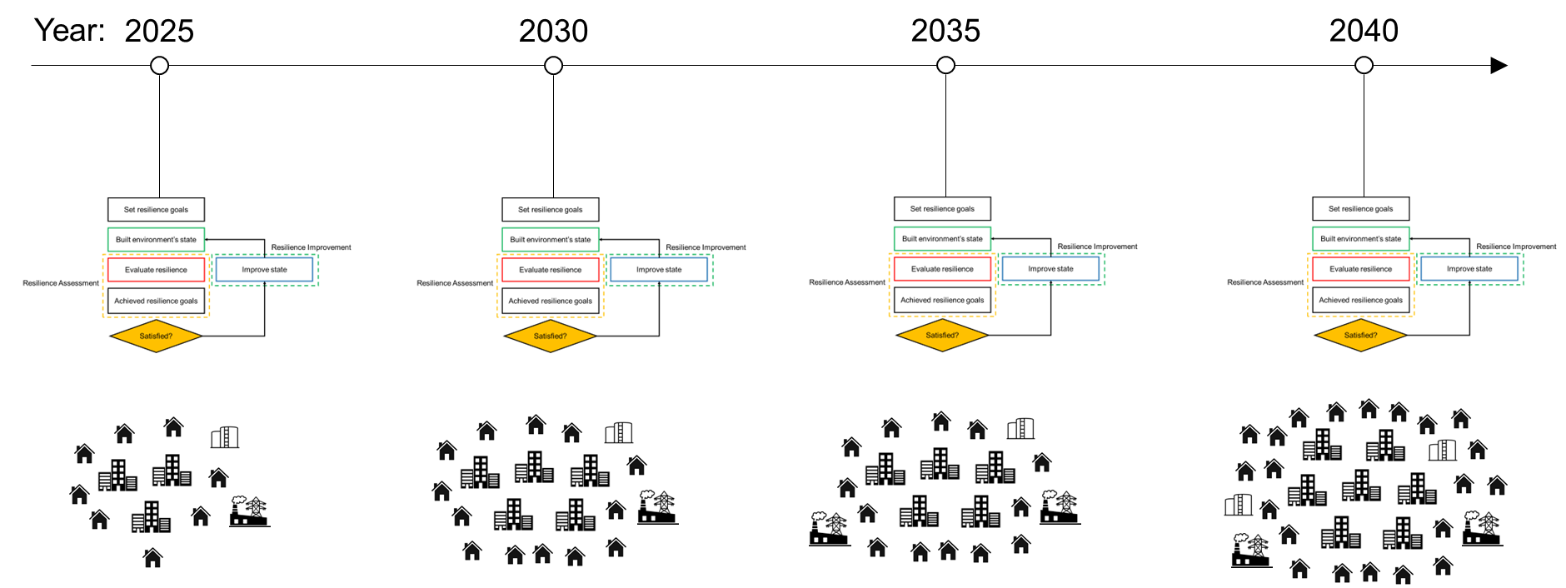
Conclusion
iRe-CoDeS framework provides a foundation for simulating regional recovery and assessing built environment’s resilience:
Bottom-up framework – the effect of building-level interventions on community resilience can be investigated.
Component interaction simulated as a flow of resources – uses existing data on supply/demand and flow models.
Extensible and modular – third-party models can be integrated within the framework.
Can be used for probabilistic assessment of community resilience goals.
Consistent across various subsystems of the built environment.
Continuous resilience-based design of the built environment possible with the iRe-CoDeS framework.

